Slide 1

Advanced 3D Game Development
Brona Keevers-Roux
20098883
CA3 – Networked 3D Game

Slide 2
Networking Models Overview
Client – Server
Central authority
Stable + secure
Higher server cost
Peer to peer
Low infrastructure cost
Host advantage
Security issues
Hybrid
Shared simulation
Flexible authority
Common in modern middleware

Slide 3
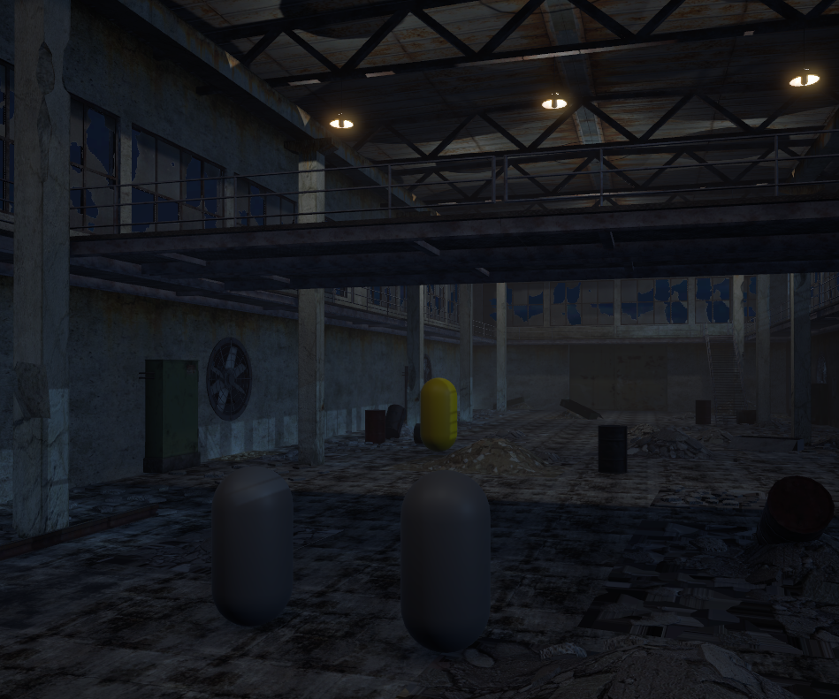
My Fusion Implementation
Fusion Shared Mode
InputAuthority per player
Distributed StateAuthority
Session-based replication
Implemented Features
Session join
Network spawning
Player ownership
Authentication flow

Slide 4
Authority Models (Fusion vs unreal)
Fusion
InputAuthority
StateAuthority
Shared Mode
Unreal Engine 5
Server
Owning client
Simulated proxy

Slide 5
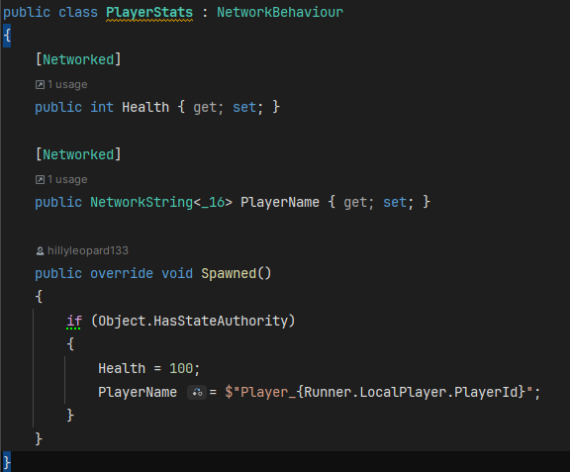
Replication and Synchronisation
Fusion
[Networked]
Tick-based replication
RPC support
Unreal
Replicated UPROPERTY
Server replication
Multicast RPCs

Slide 6
Lag and Latency
Sources of lag
RTT
Packet loss
Jitter
Tick delay
Problems
Rubberbanding
Input delay
Desync

Slide 7
Compensation Techniques
Client Prediction
Local immediate movement
Server Reconciliation
Correcting incorrect prediction
Interpolation
Smoothing remote movement
Extrapolation
Guessing future state

Slide 8
Authentication + Access Control
Why authentication matters
Prevent anonymous abuse
Identify users
Secure multiplayer services
My implementation
Unity Authentication
Anonymous sign-in
Fusion integration

Slide 9
Industrial Expectations and Trends
Industry Expectations
Authority understanding
Replication systems
Debugging skills
Version control discipline
Emerging Trends
Cloud-hosted multiplayer
Large-scale sessions
Hybrid authority systems
Deterministic networking

Slide 10
Reflection
What went wrong
Incorrect shared mode assumptions
Callback ordering issues
Session instability
What I’d change
Better modularity
Earlier networked state design
More structured debugging workflow

